Slide 1

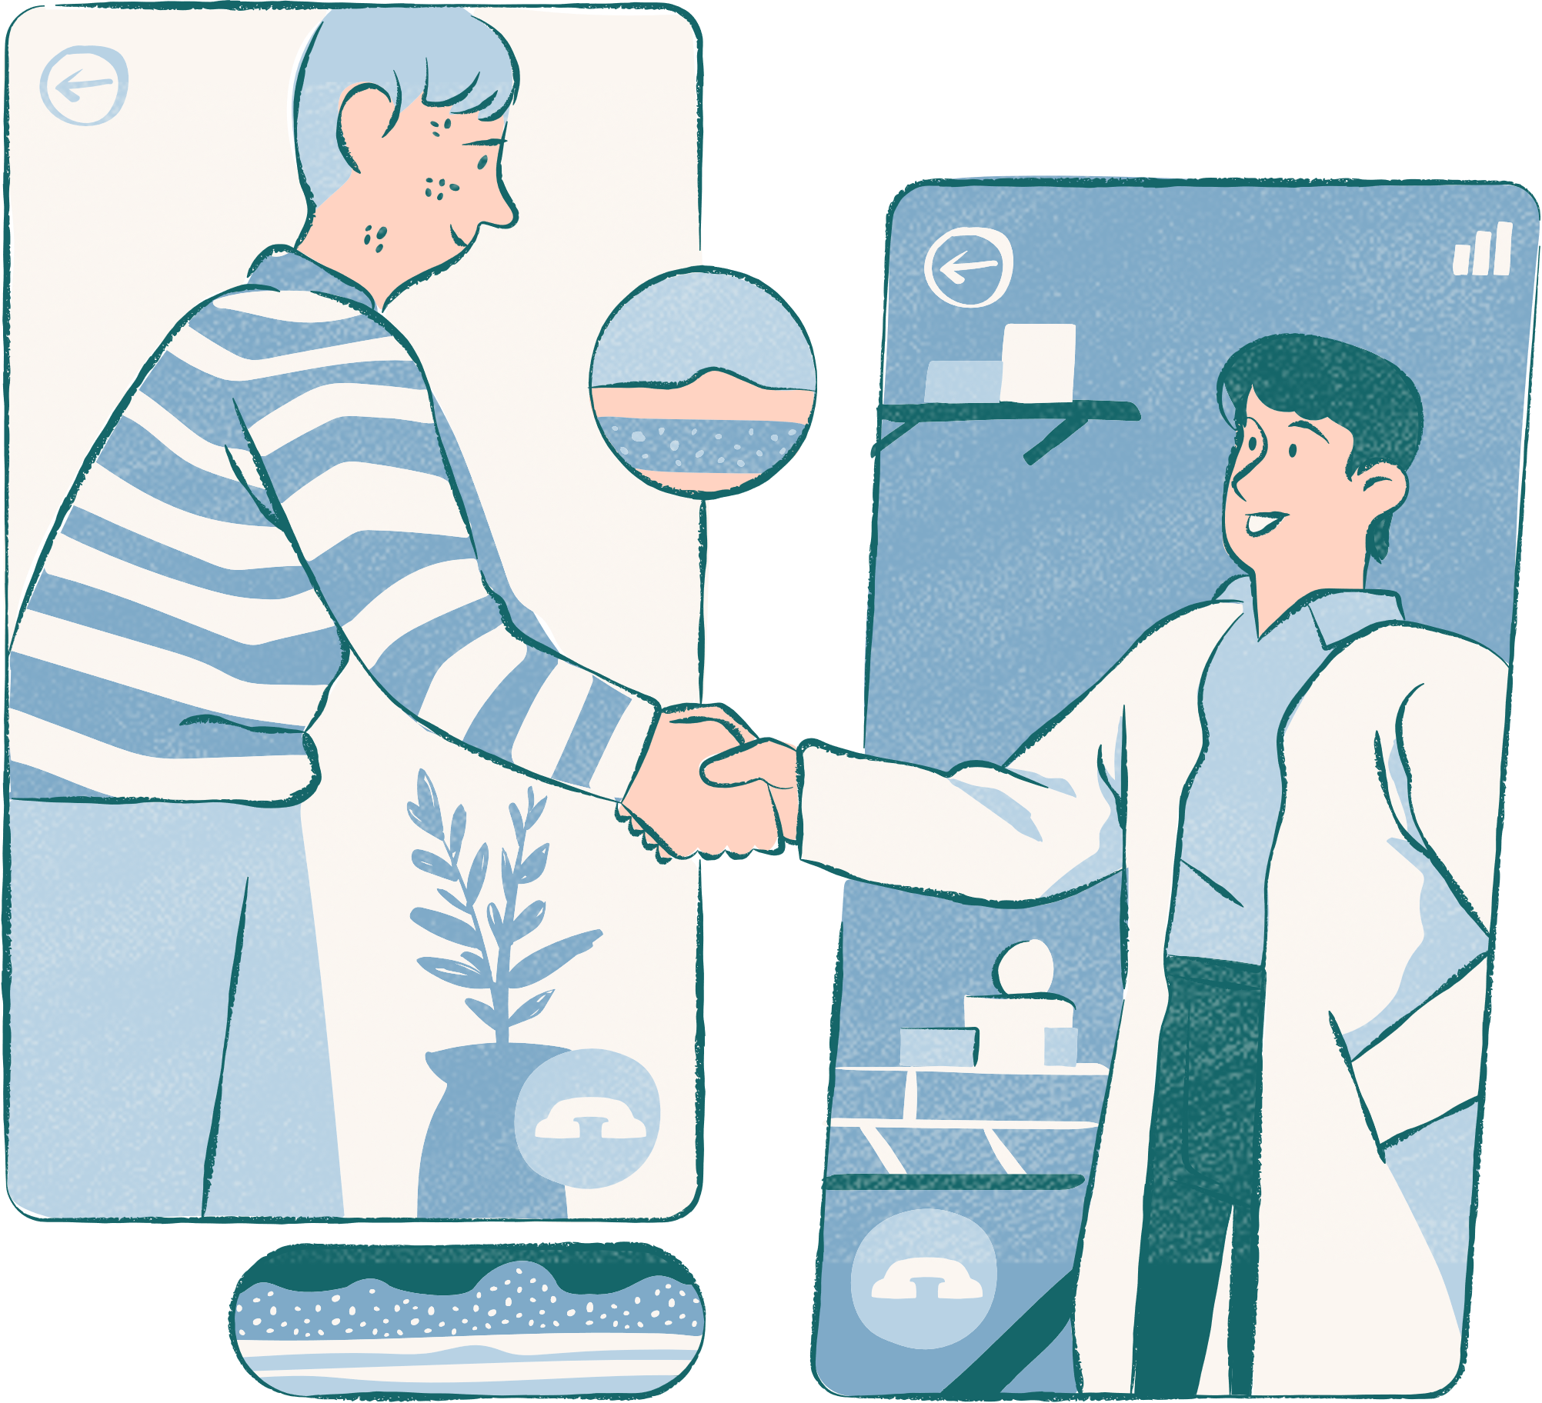
HealthXplorers
Your health, our mission
Addressing every need

Slide 2
Problem Statement
Developing a Unified Patient Treatment Platform
for Healthcare Advancement with focus on patient empowerment and facilitating patient- doctor relationship

Slide 3

Introduction
The developers- Karthik V(Team lead) and Sumedh Kudale have worked on this project. This project comes under healthcare track. We are commited to the well-being of mankind. We have developed a fully working digital product made in 48Hours

Slide 4
Timeline of Digital product Development

Slide 5
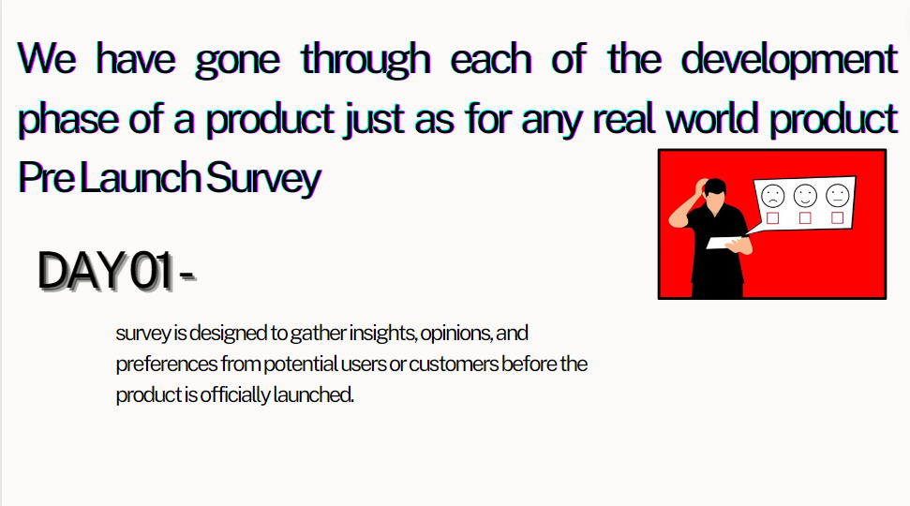

Slide 6
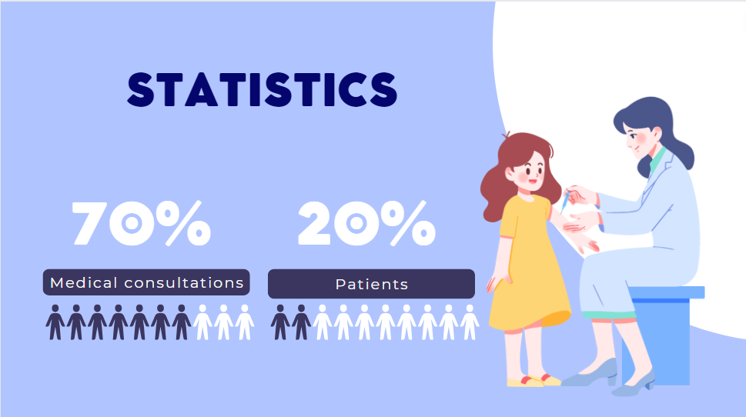

Slide 7
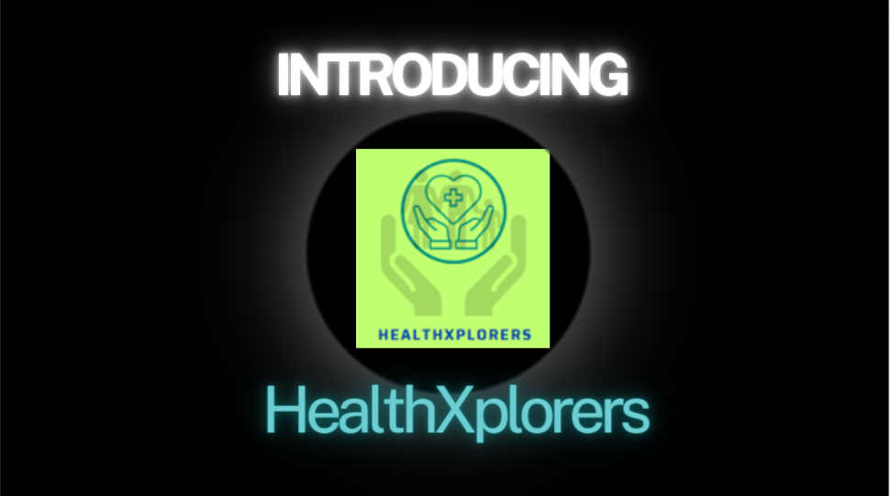

Slide 8
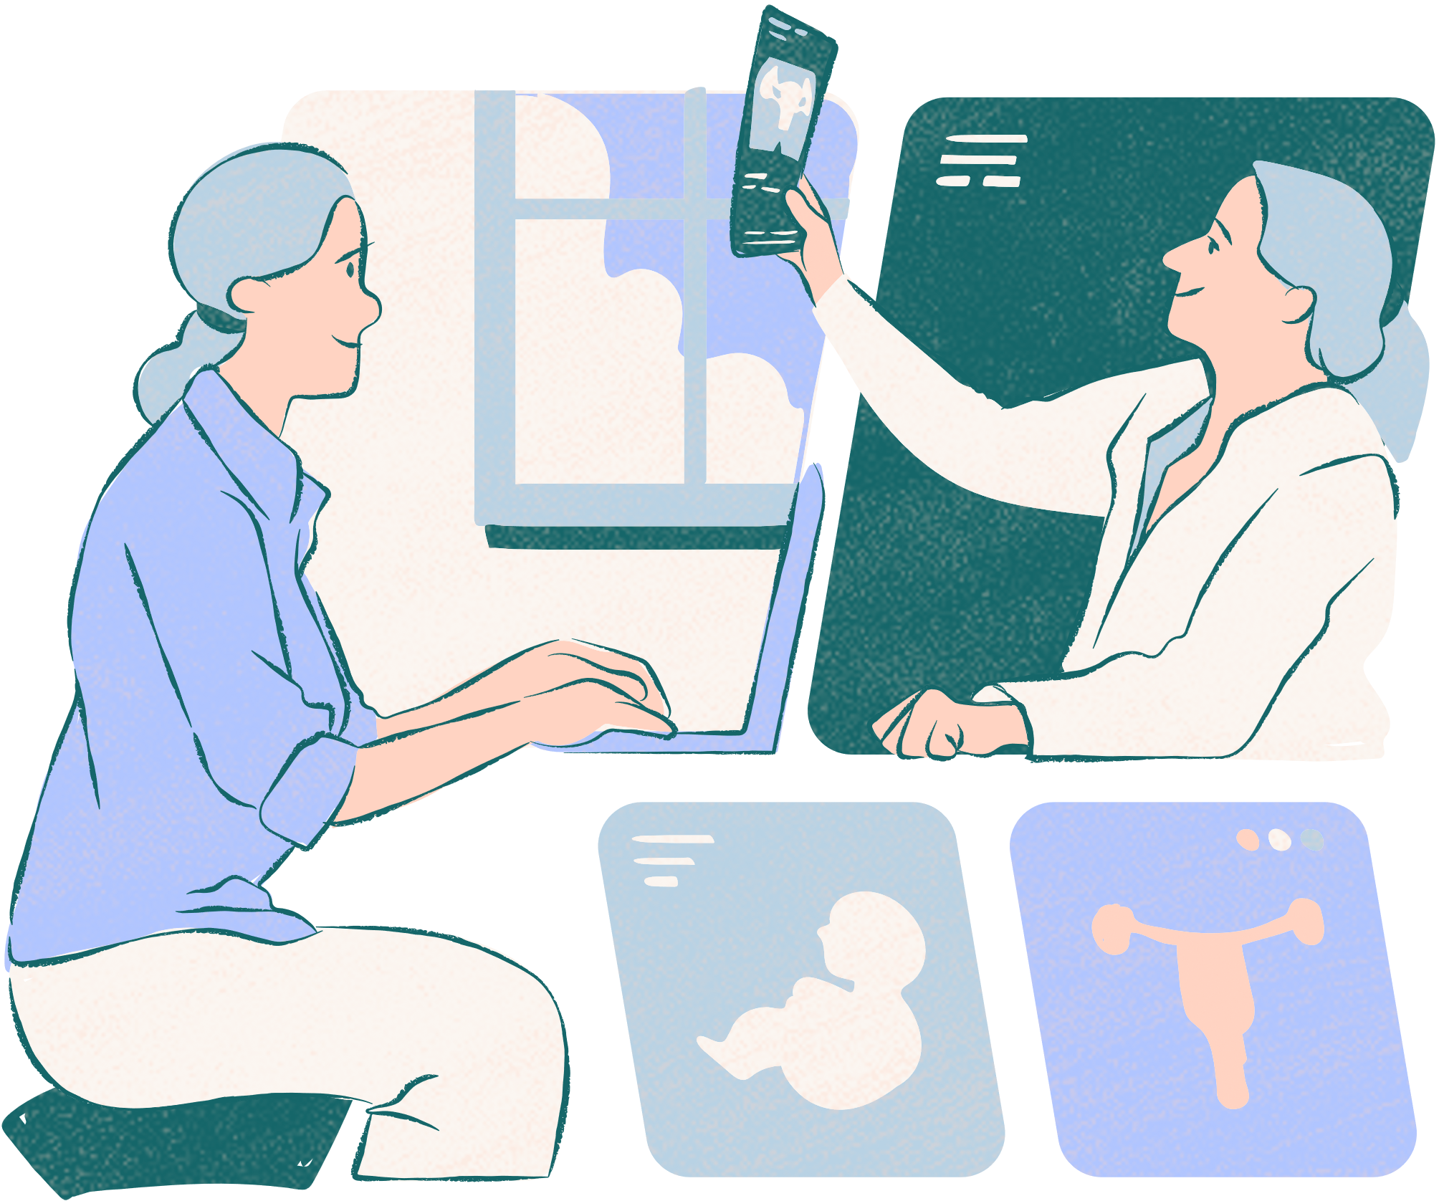
Idea Overview
We have created a UPTP with the following features:
Patient Centric Access
Allows real time updating
Can be integrated with Health Level 7 standard data
Allows doctors to store patient details in tabular format real time
Allows for checking of drug interaction
Special focus on Data privacy

Slide 9
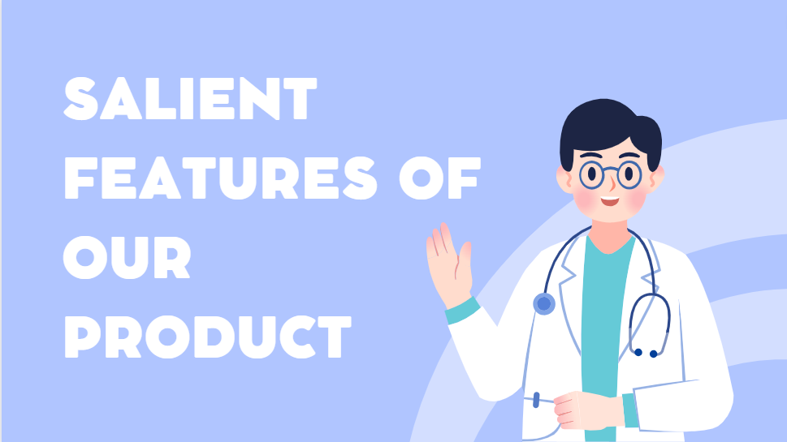

Slide 10
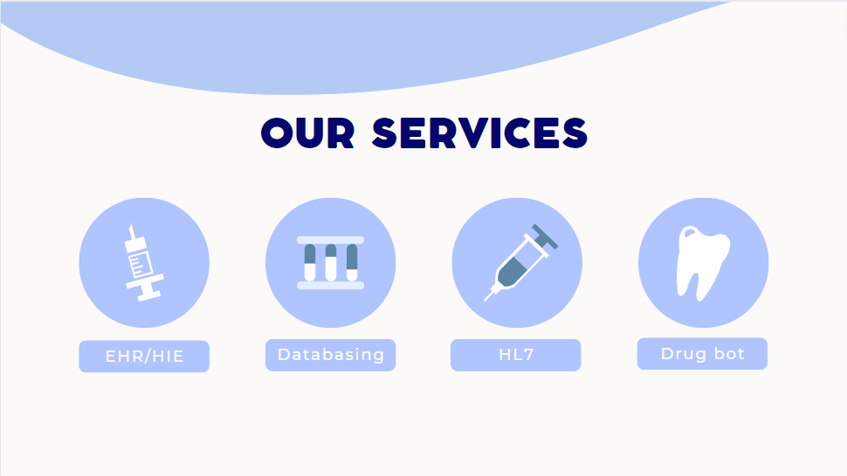

Slide 11
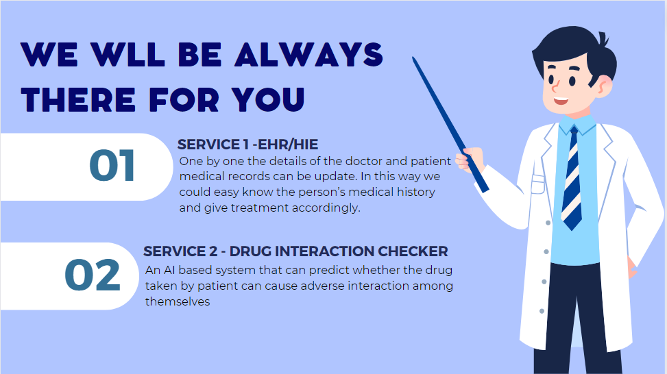

Slide 12
Idea overview
Services
Data system:
Can register to create different profiles for patients
Can store the patients medical details along with photo
Patients or doctors can login to see/edit profiles
Password protected
03.
04.
Health Level 7 file converter:
Can convert Health level 7 messages to csv or excel for importing to database
Can also convert csv or excel to Health level 7 messages for exporting data

Slide 13
Achievements/ Current features
Following objectives were achieved:
1.Advanced Patient Empowerment
2.User friendly Interface
3.AI-Driven Clinical Excellence
4.Holistic Data Integration
5.Security for databases
6. EHR Implementation
7. Drug Interaction AI
8. Dynamic updating
9. Interoperability, scalability
10. Implementation of unique valid and trustable identity with privacy

Slide 14
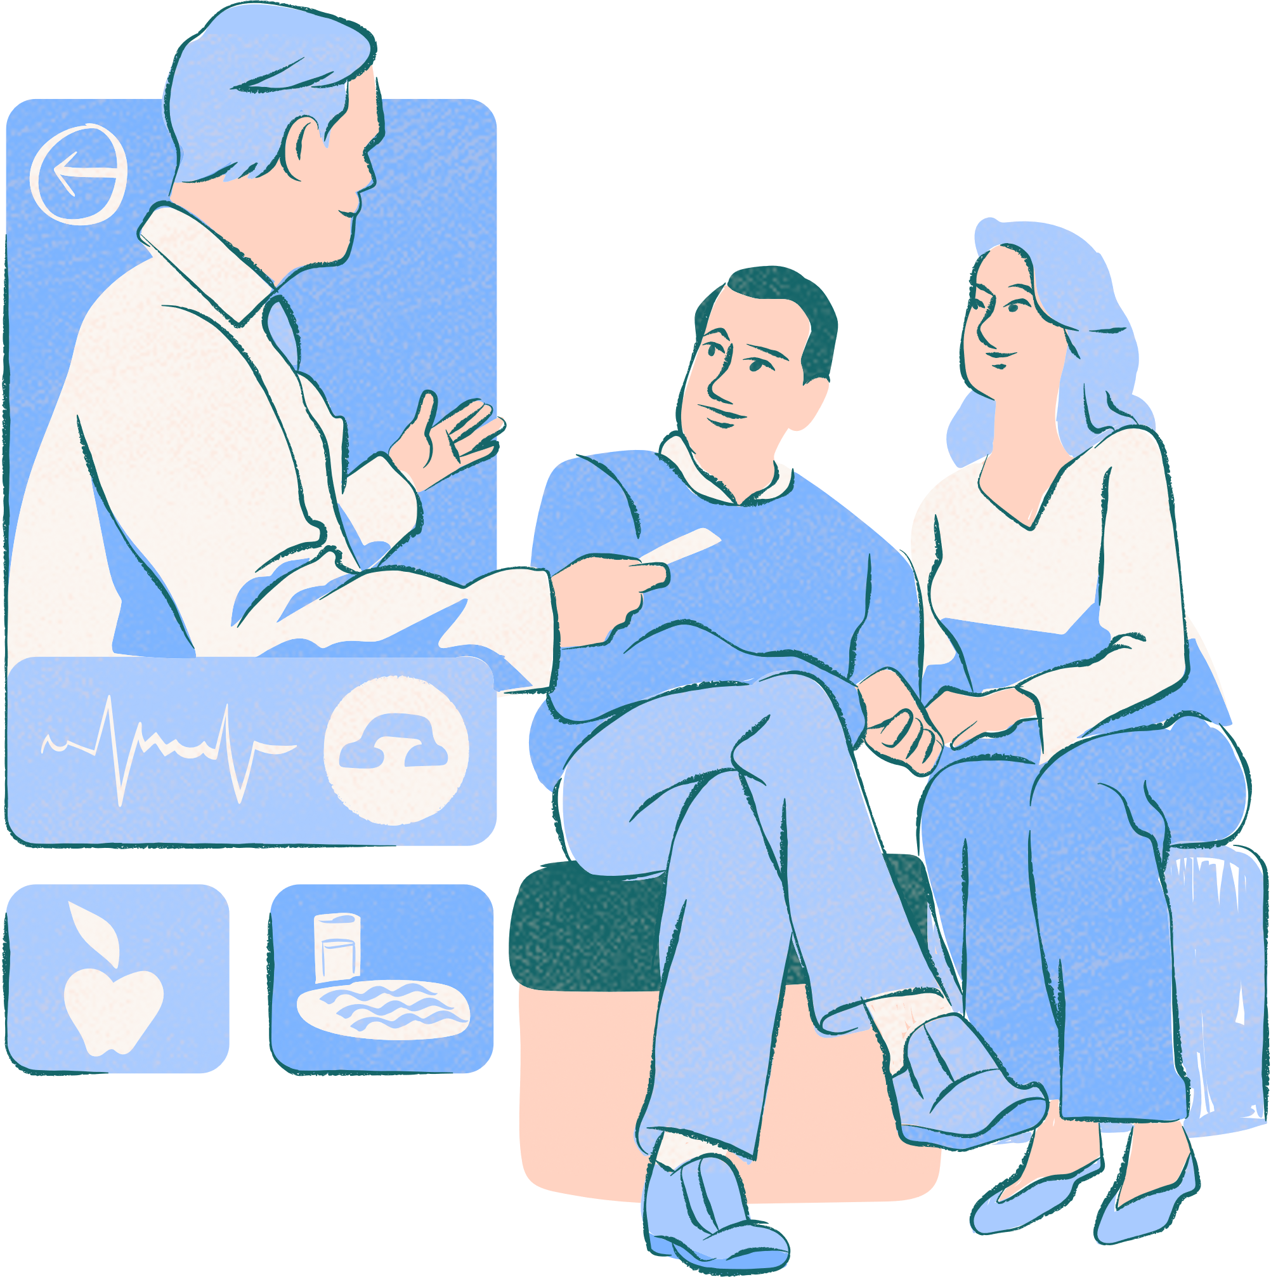
Technical Overview
Following technologies were used in this project:
Django with Python
HTML,CSS,JavaScript
SQLite Databases

Slide 15
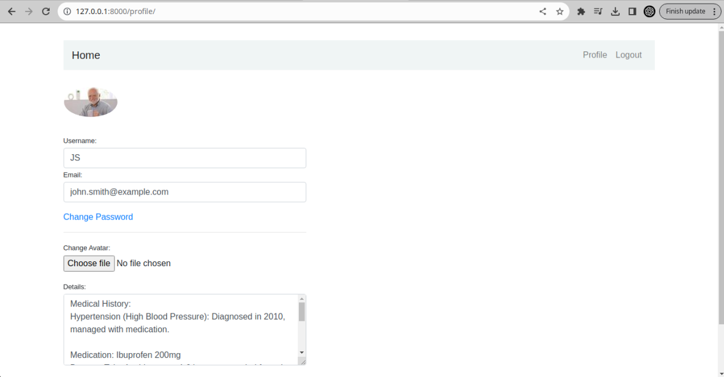

Slide 16
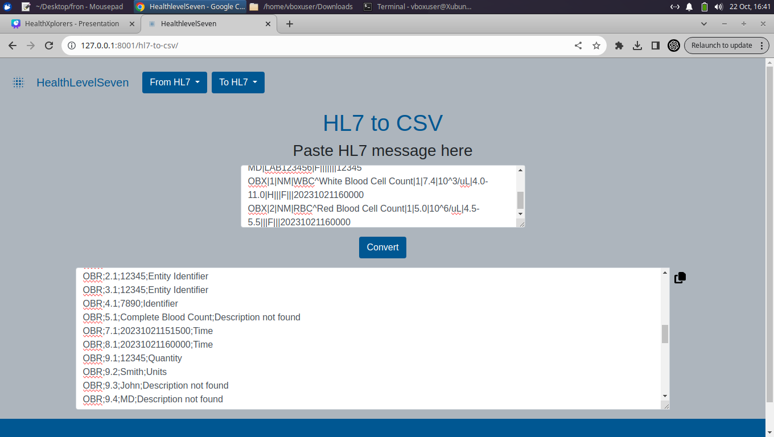
Execution

Slide 17
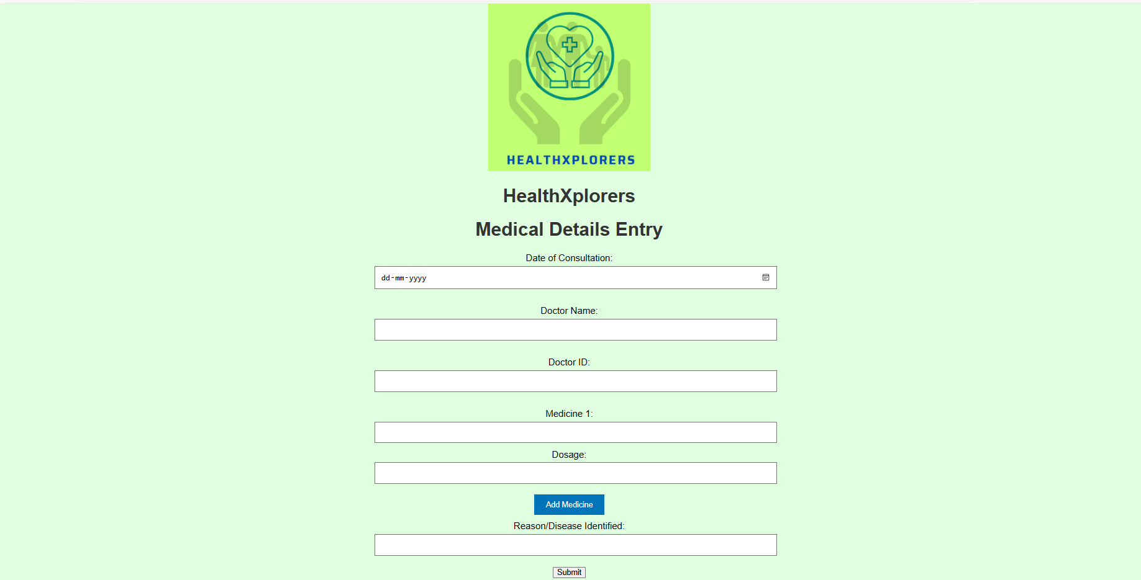

Slide 18
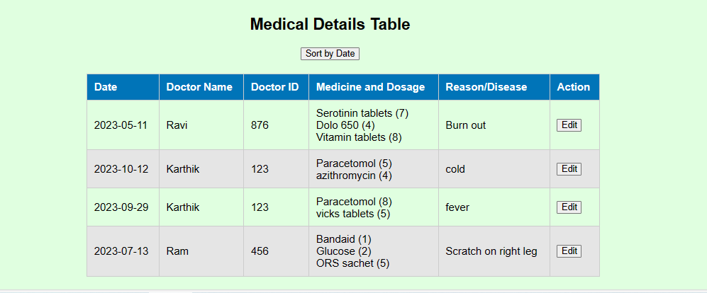

Slide 19
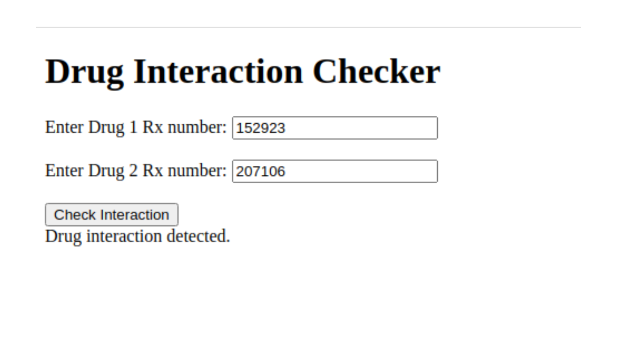

Slide 20
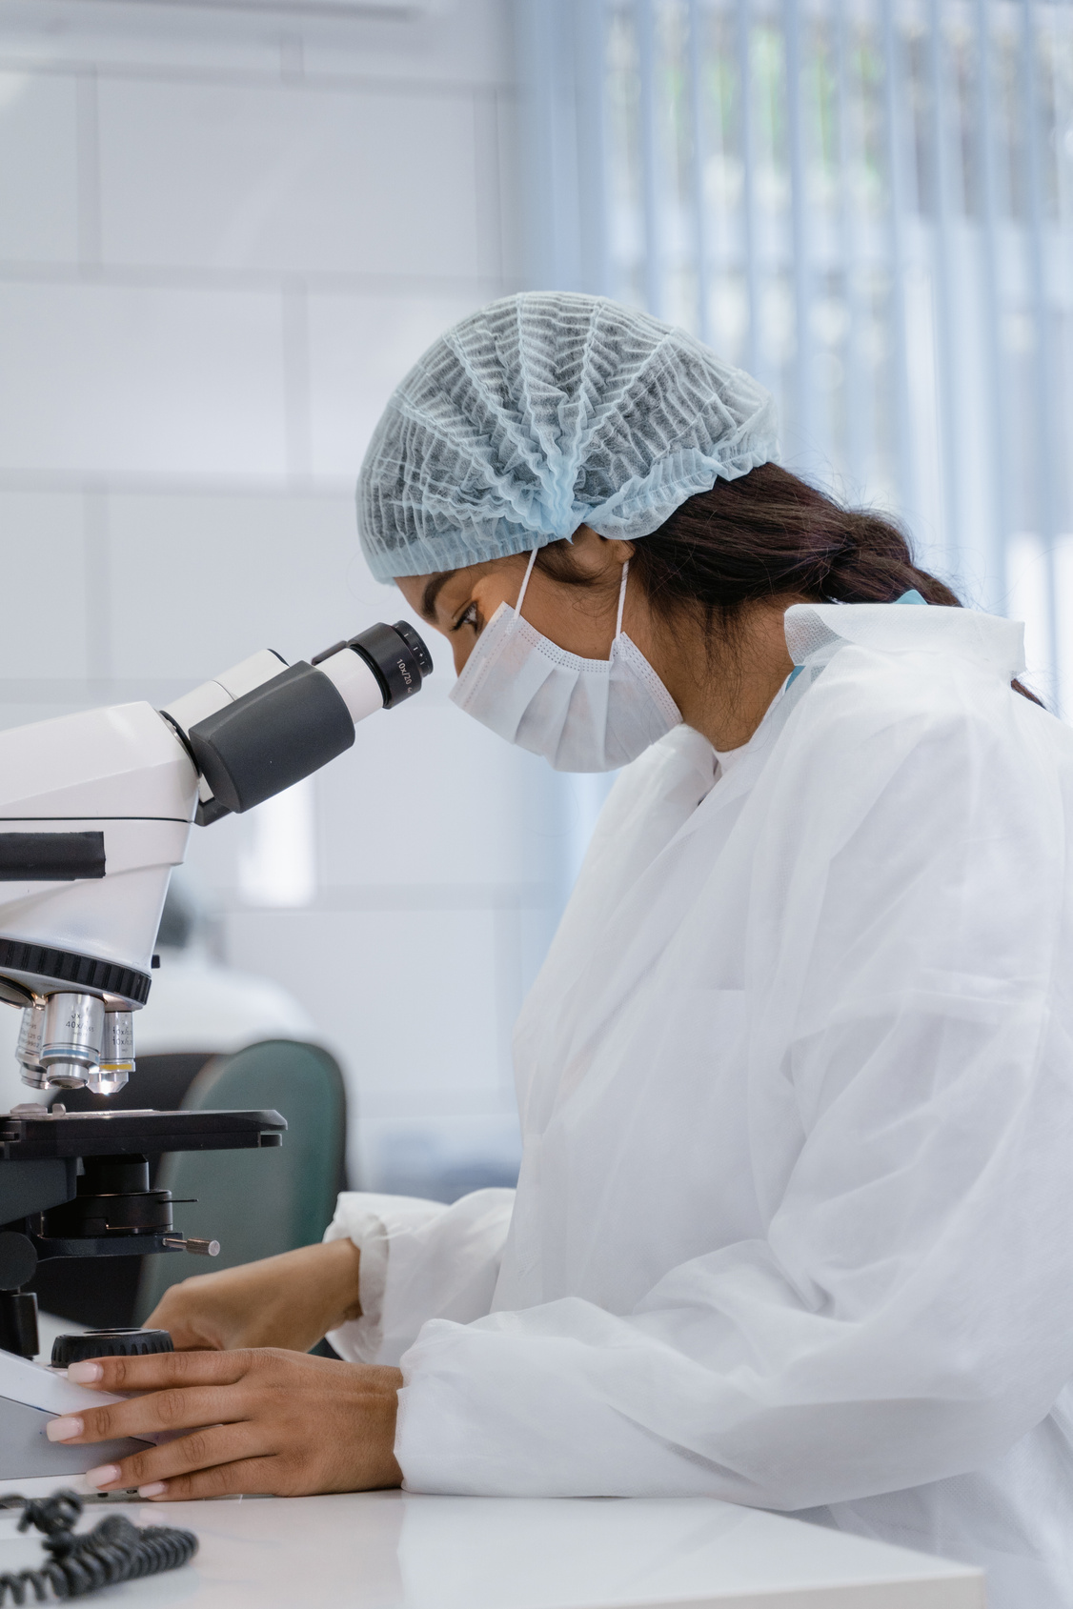


DOCTOR
Doctors can use the platform to help them assist keeping track of data , and transfer the data to any other system.
PATIENT
Patients can ask AI systems for preliminary help. Patients can know what are the medicines being prescribed to them. Using the NHA/ HPR of the doctor, patients can know more of their consulting doctor too. Always this will help in building mutual trust between patient and doctor. And also facilitate faster and better treatment.

Slide 21
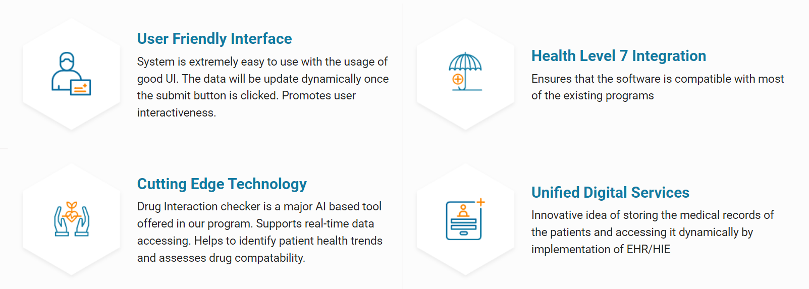
Benefits of our App/idea

Slide 22

Future Scope/
Market Prospects
-The system is already capable of storing as many number of profiles as needed.
-The Health Level 7 conversion system can be integrated into the profile application to upload data directly.
-Image analysis can also be used in the profile application for medical analysis as soon as image is uploaded.
-Number of AI subsystems can be increased

Slide 23

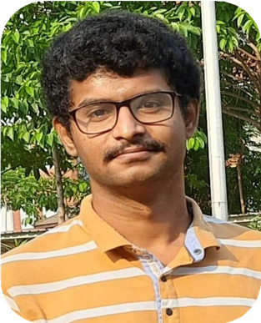
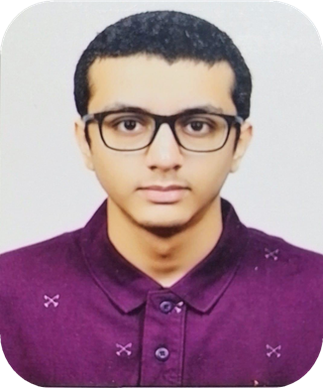
Our Developers
Dedicated Professionals
KARTHIK V
SUMEDH DEEPAK KUDALE

Slide 24



CONTACT SUPPORT
9618693480
healthxplorers39@gmail.com

Slide 25
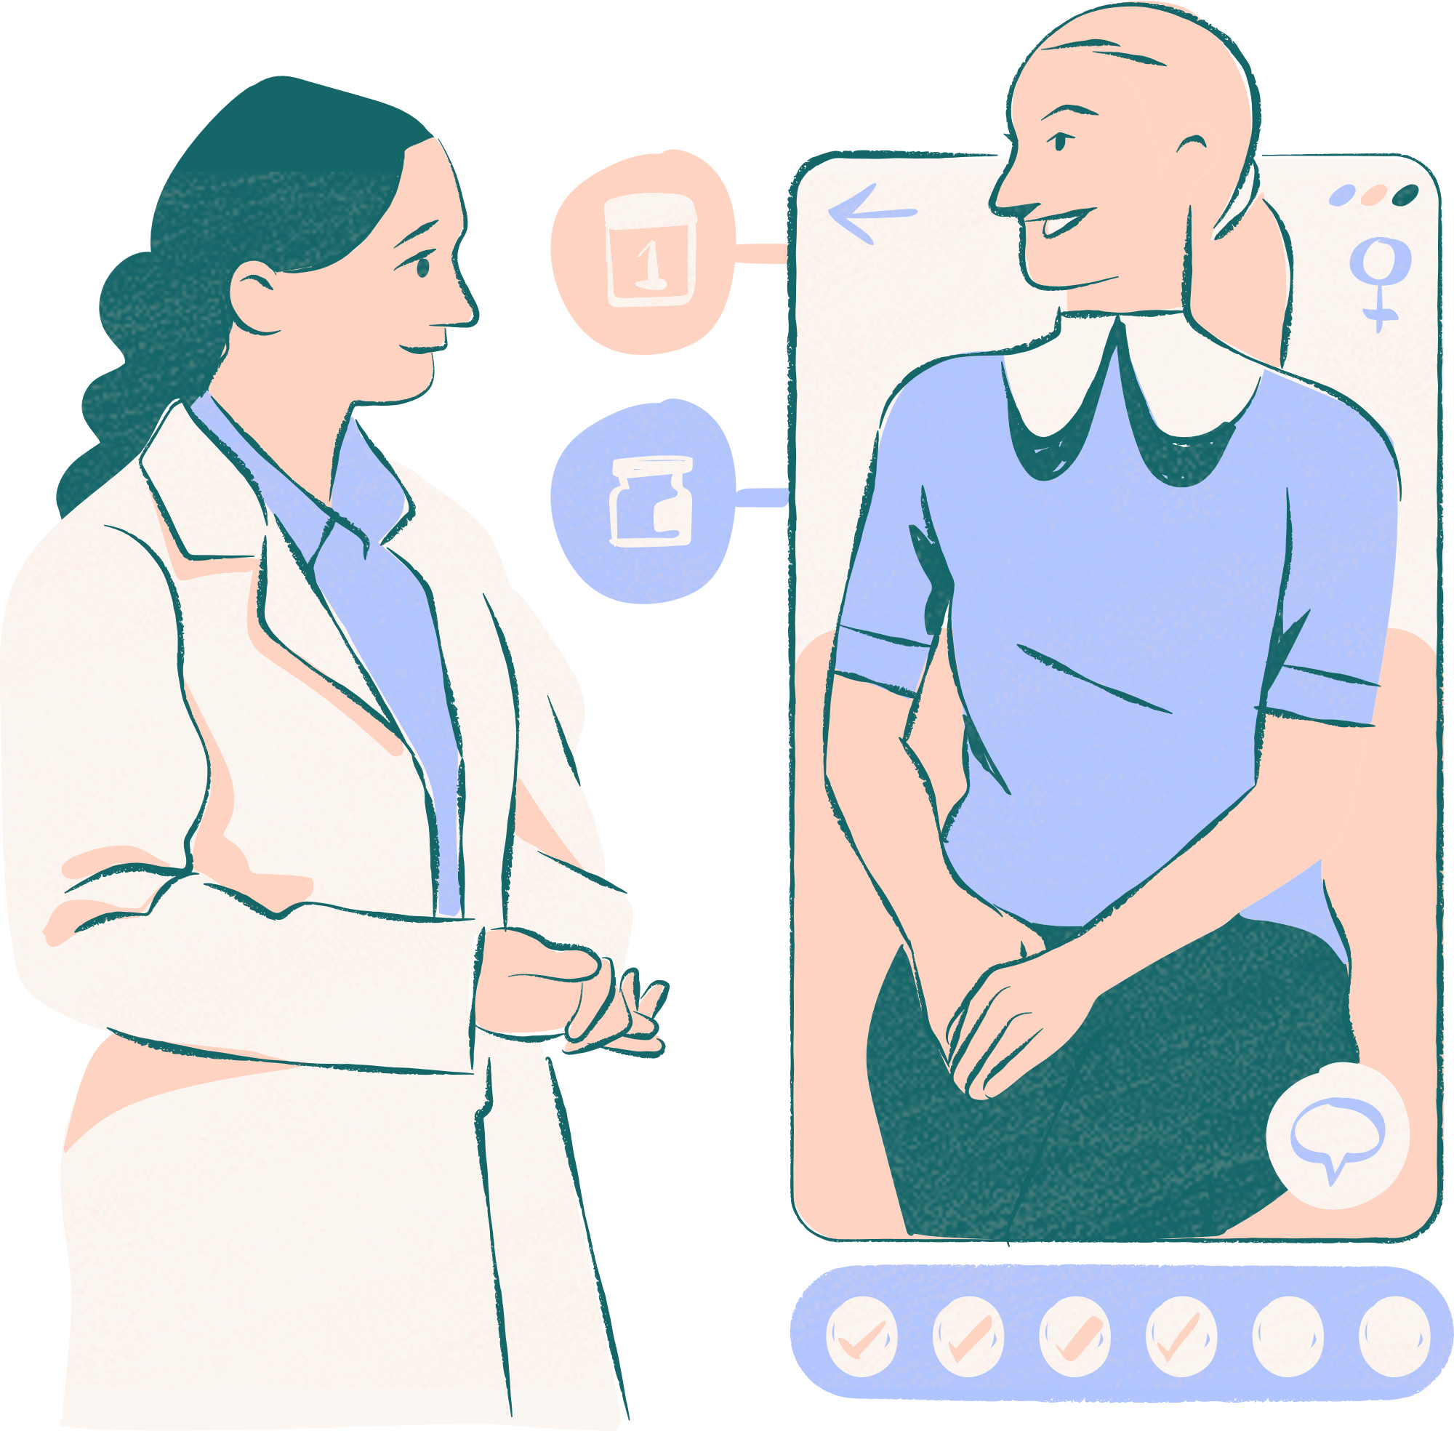
HealthXplorers
Thank you very much!

